Slide 1
IPython/Jupyter and the .NET Framework
Hiroshi Nishimura
ATAP/ALS
H_Nishimura@lbl.gov

Slide 2
C#
A primary compiler on the .NET Framework.
If Java is a C++ made right, C# is a Java made right.
C# is very close to C++ but managed.
Open source!
Available on Linux and Mac with Mono
Battery included
Direct access from the standard Python!

Slide 3
Compatibility of C# with Python
C# libraries (called Assembly) contains metadata. Therefore, we can avoid creating the wrappers.
Python for .NET is the Python module that accepts the .NET assemblies dynamically.
Routines in C#, Visual Basic, F# are all available in the Notebook.

Slide 4
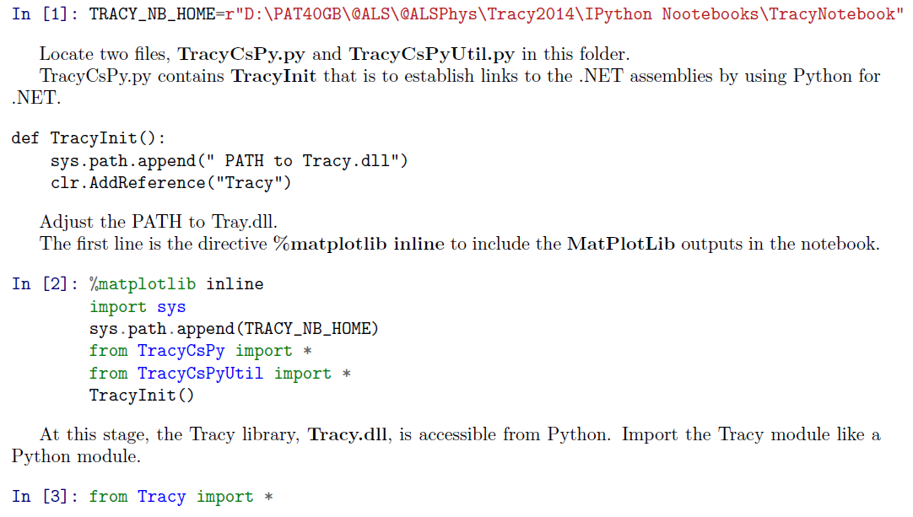

Slide 5
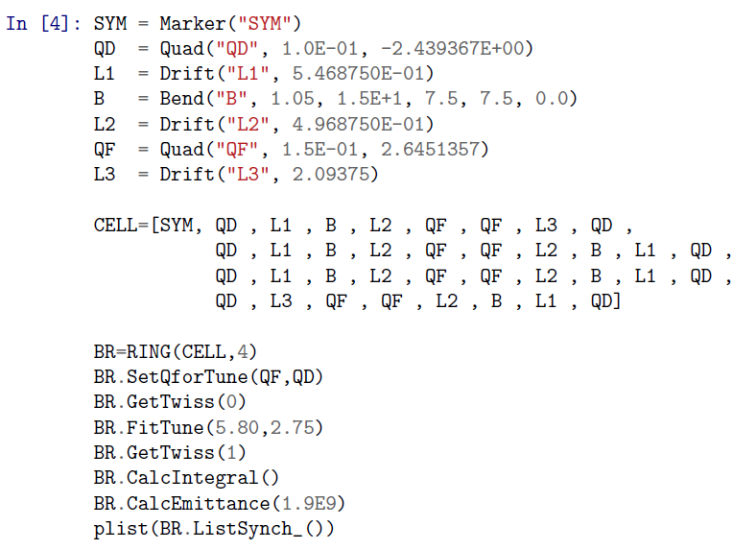

Slide 6


